Slide 1
Iowa Climate Science Educators Forum Infectious Diseases - bugs and vector
Dr. Yogi Shah MD, MPH
Des Moines University

Slide 2
Climate Change and Human Health
Storms and Flooding
Morbidity / Mortality / Displacement
Heat
Cardiovascular and respiratory mortality
Global climate change effects:
Temperature
Precipitation
Humidity
Vector Biology
Infectious Disease
Air Pollutants
Respiratory Diseases
Food Supply
Malnutrition
Mental Health

Slide 3
Bugs and Vectors

Slide 4
Ticks
Lyme
Climate change
Temperature
Precipitation
Humidity
Vectors
Infectious Disease
Malaria
Mosquitoes
Dengue
Chikungunya
West Nile Virus

Slide 5
What makes Infectious Diseases Our Issue?

Slide 6
More than 30 agents have emerged during the past two decades

Slide 7
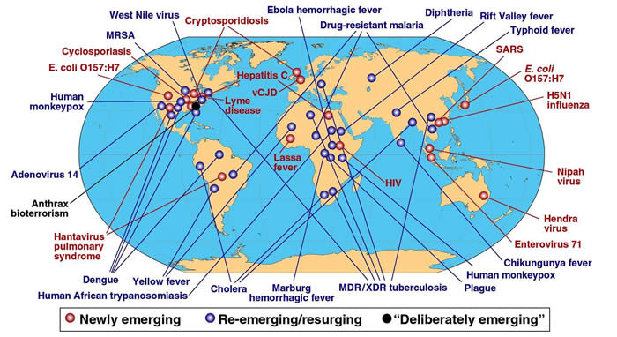

Slide 8
Vectors

Slide 9
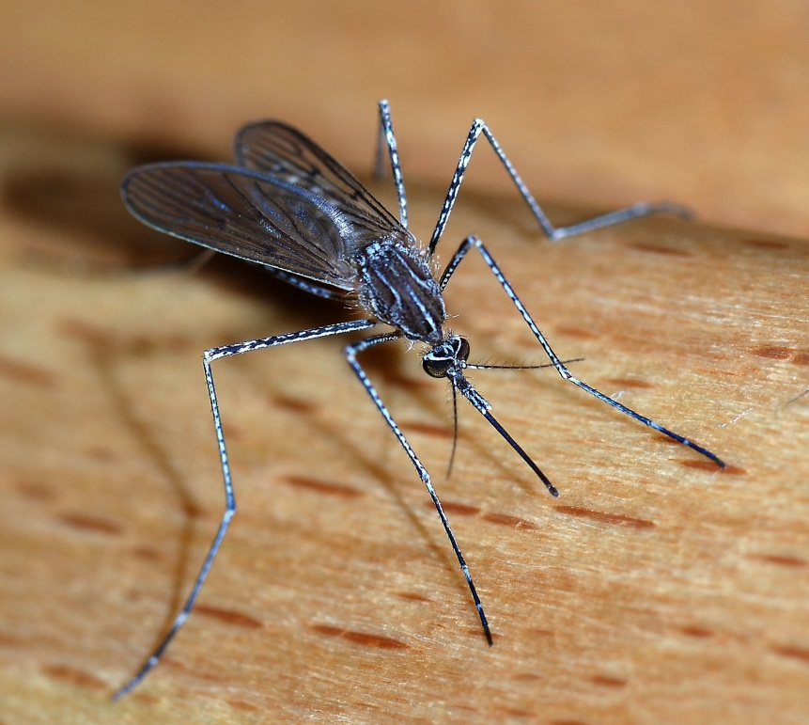
Mosquitoes and climate

Slide 10
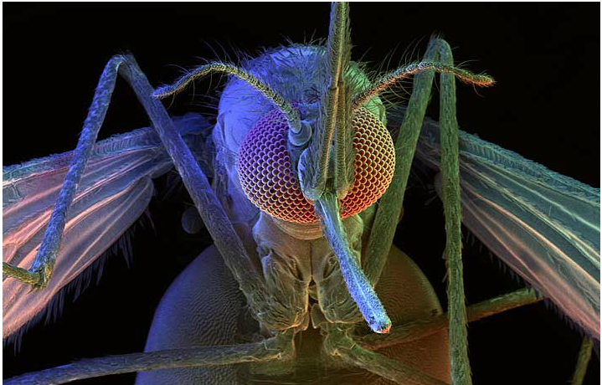

Slide 11
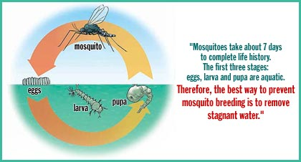
Temp. dependent

Slide 12
30c =86f
20c= 68f

Slide 13
Climate change can sting us literally

Slide 14
Global climate change effects:
Temperature
Vector Biology
Infectious Disease
Mosquitoes
Malaria
Dengue
Chikungunya
West Nile Virus

Slide 15
Malaria

Slide 16
Mosquito (Anopheles) – Plasmodium (P. Falciparum, P. Vivax..)
200 million cases/year
600,000 deaths

Slide 17
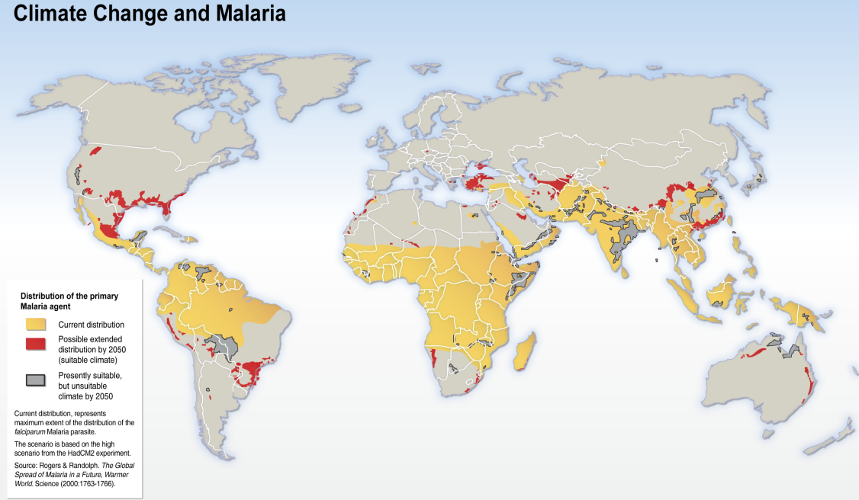

Slide 19
30c =86f
20c= 68f

Slide 20
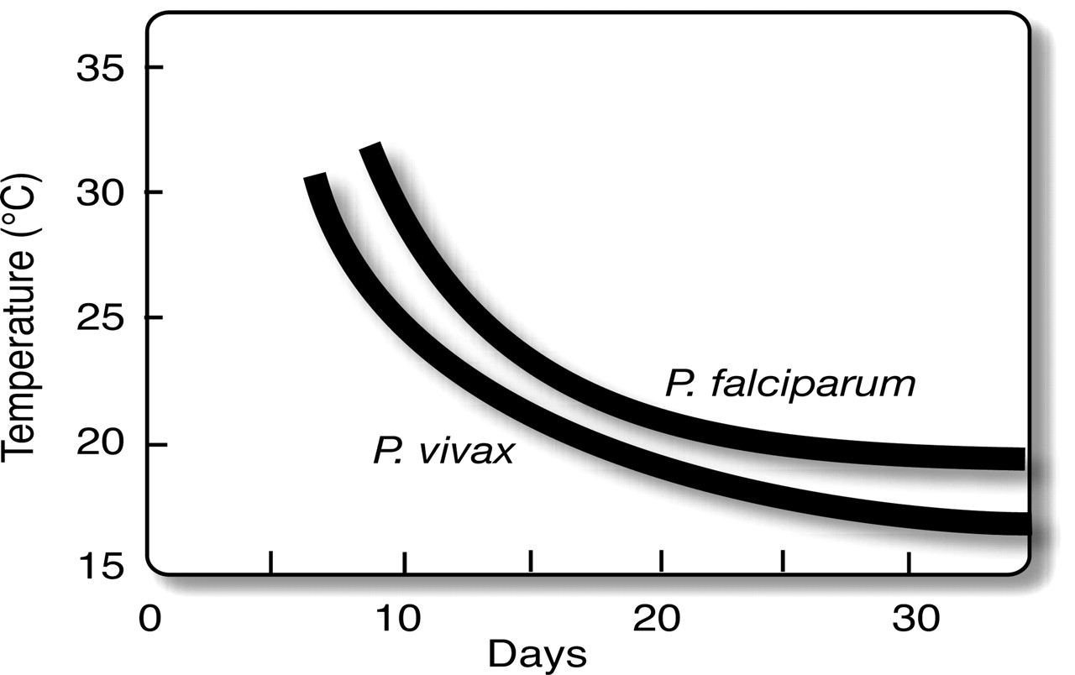
Relationship between temperature and malaria parasite development time inside the mosquito (“extrinsic incubation period” or EIP).
30c =86f
20c= 68f
Patz J A , and Olson S H PNAS 2006;103:5635-5636
Notes:
Relationship between temperature and malaria parasite development time inside the mosquito (“extrinsic incubation period” or EIP). EIP shortens at higher temperatures, so mosquitoes become infectious sooner. Note the nonlinear response to temperature, as well as relative threshold limits for malaria parasite development (≈18°C and 15°C for P. falciparum, and P. vivax, respectively) (adapted from ref. 16).

Slide 21
30c =86f
20c= 68f
Patz J A , and Olson S H PNAS 2006;103:5635-5636
Notes:
Relationship between temperature and malaria parasite development time inside the mosquito (“extrinsic incubation period” or EIP). EIP shortens at higher temperatures, so mosquitoes become infectious sooner. Note the nonlinear response to temperature, as well as relative threshold limits for malaria parasite development (≈18°C and 15°C for P. falciparum, and P. vivax, respectively) (adapted from ref. 16).

Slide 22
Number of malaria cases- largest since 1971
50% increase from 2008
CDC

Slide 23
Malaria
Global climate change effects:
Temperature
Mosquitoes
Dengue
Chikungunya
West Nile Virus

Slide 24
Chikungunya(ChikV)

Slide 25
Mosquito (Aedes aegypti and Ae. Albopictus) -viral infection

Slide 26
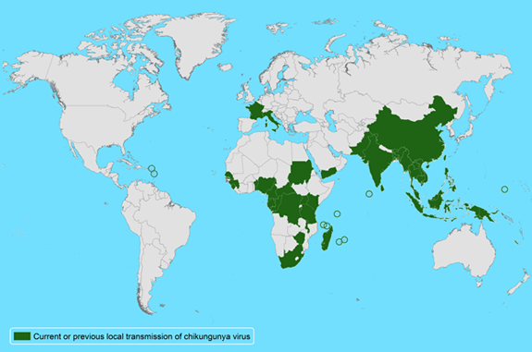

Slide 28
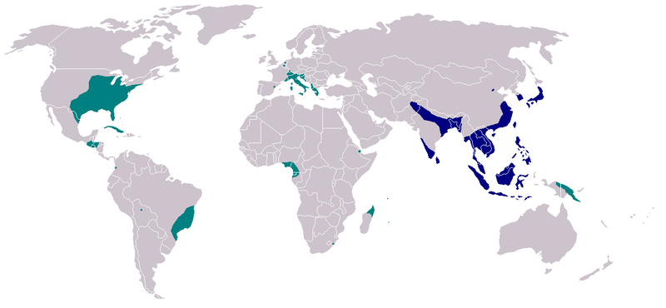
Ae. Albopictus distribution 2007

Slide 29
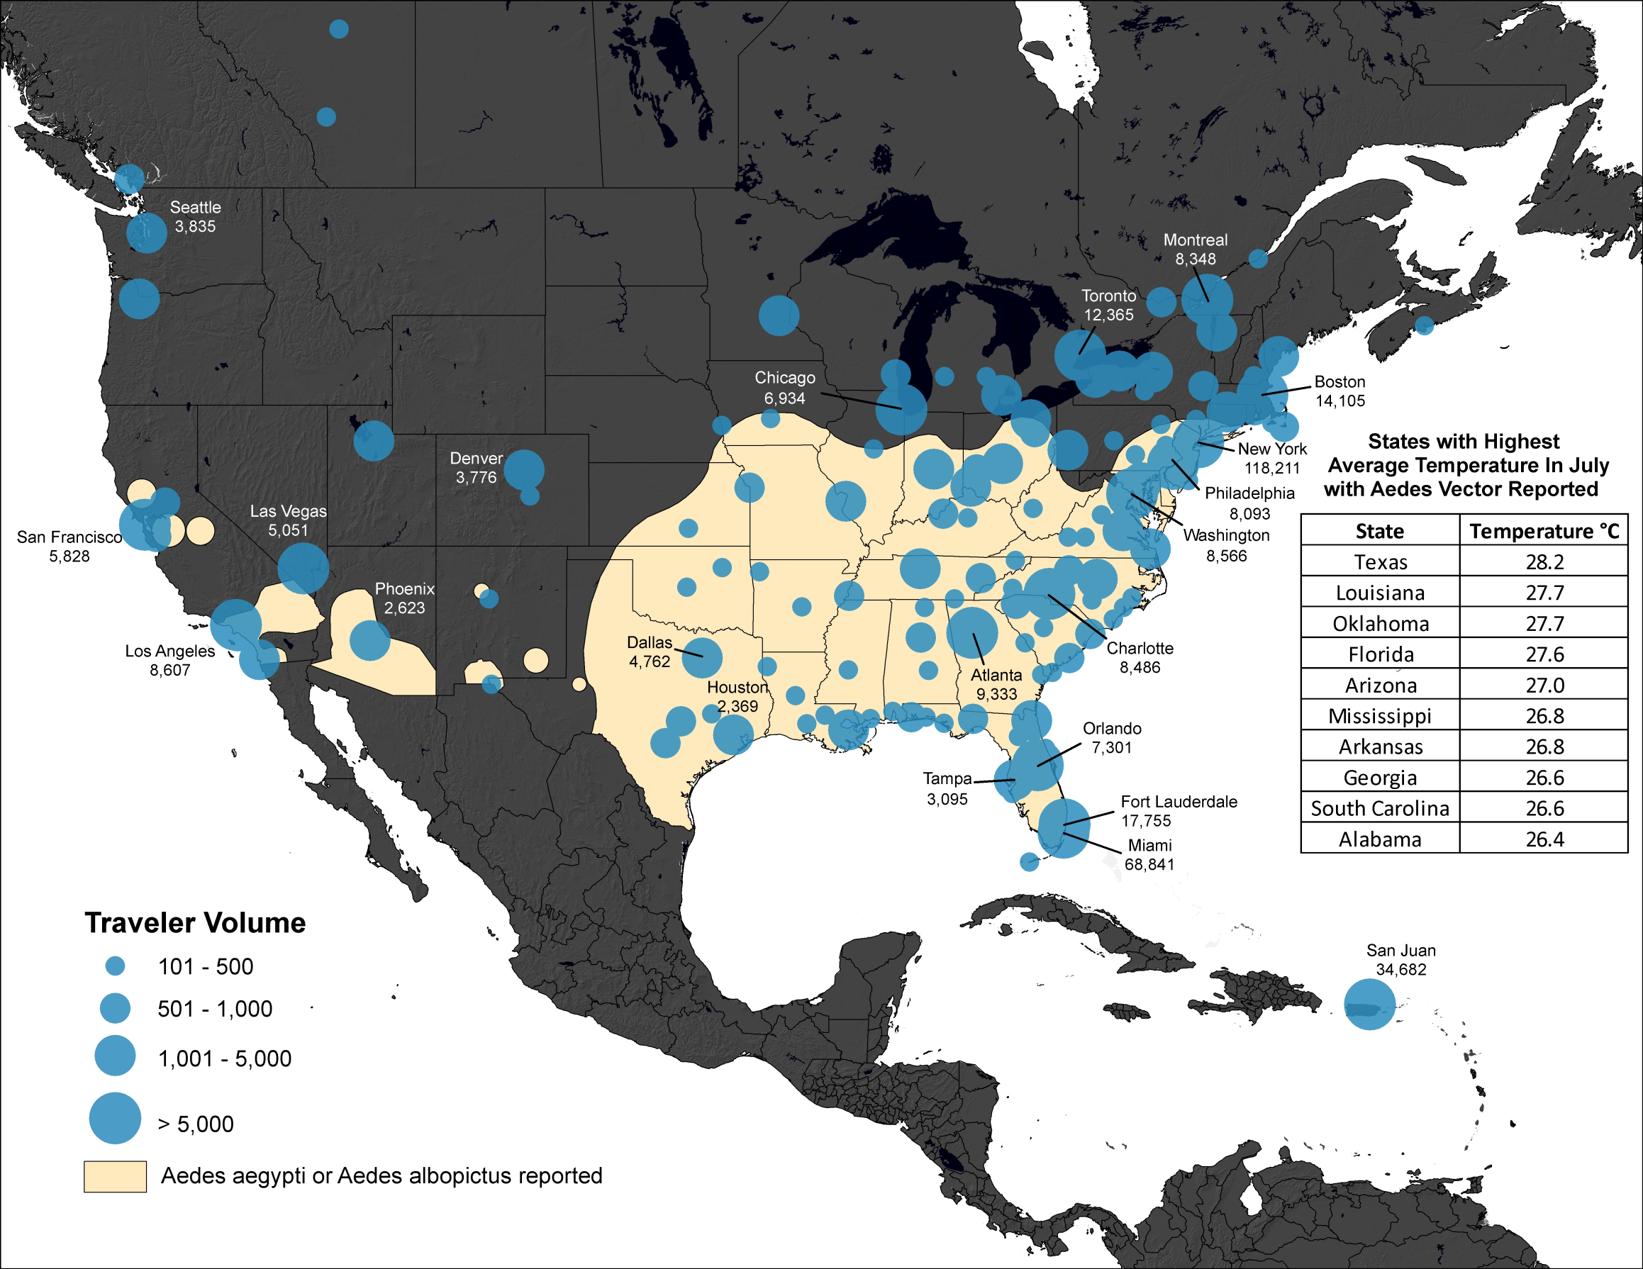

Slide 30
Malaria
Global climate change effects:
Temperature
Mosquitoes
Dengue
Chikungunya
West Nile Virus

Slide 31
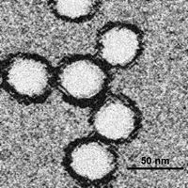
West Nile Virus Disease

Slide 32
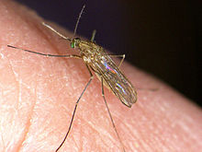
Mosquito (Culex Pipiens) - West Nile virus (WNV)

Slide 33
1999
Notes:
West Nile virus was first detected in North America during 1999. While West Nile virus-infected birds were detected from many eastern counties, human illness was confined to the New York City region.

Slide 34
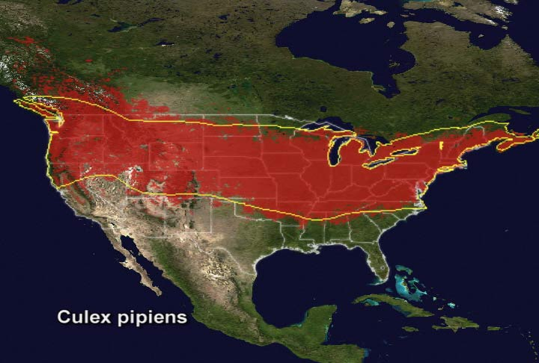

Slide 35
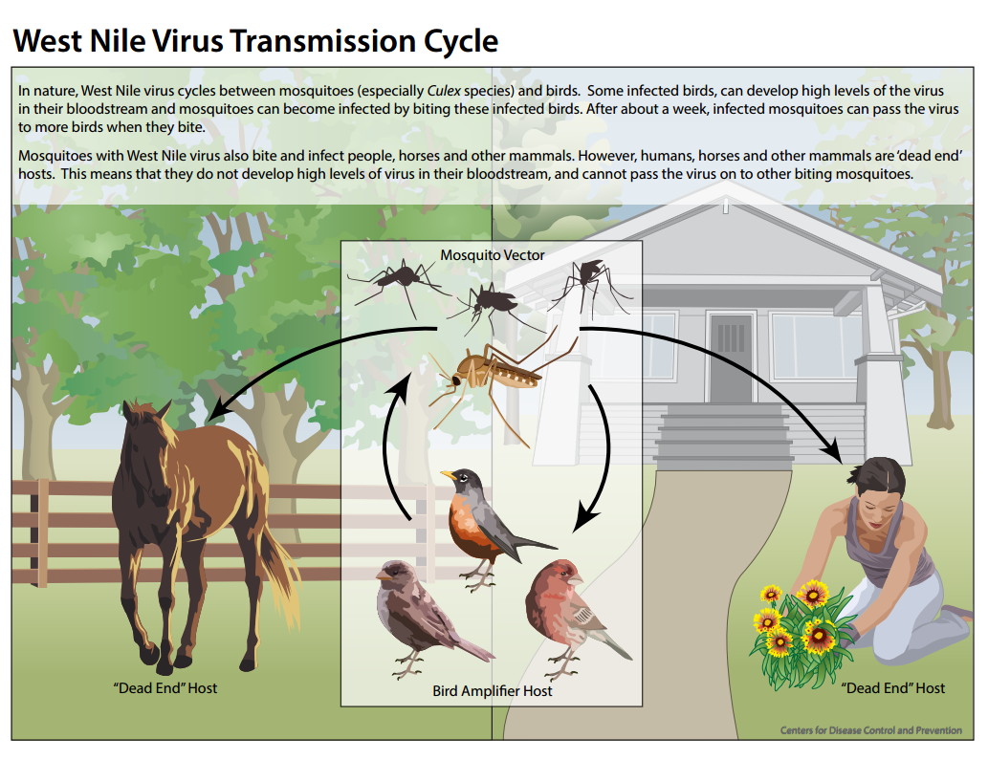

Slide 37
1999
Notes:
West Nile virus was first detected in North America during 1999. While West Nile virus-infected birds were detected from many eastern counties, human illness was confined to the New York City region.

Slide 38
2002
Notes:
By 2002, West Nile virus had spread rapidly across the eastern two thirds of the United States. This was the first year the virus was detected in Minnesota.

Slide 39
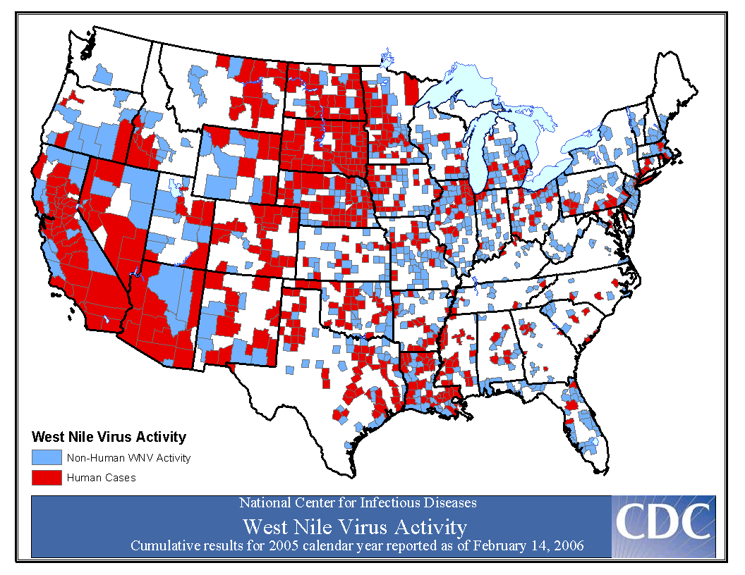
2005
Notes:
In 2005, there were 2581 human cases in 42 states, and ecologic WNV activity (virus detection in birds and mosquitoes) was seen in all 48 contiguous states.
Human cases were scattered throughout the US, but most human cases were seen in CA, the southwest, and the central mountain states.

Slide 40
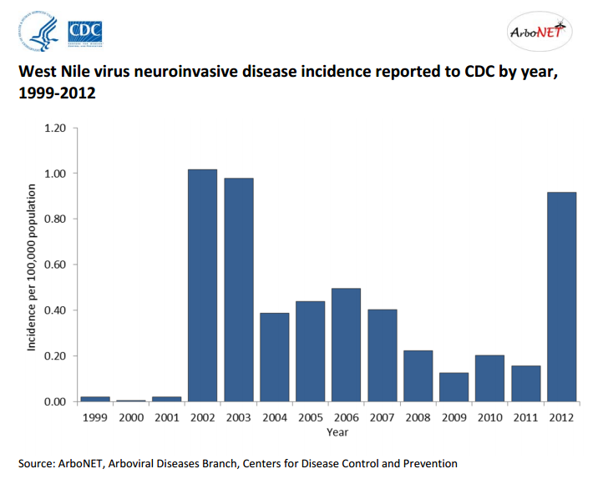
5,674
62 712

Slide 41
Climate Change and Human Health
Storms and Flooding
Morbidity / Mortality / Displacement
Heat
Cardiovascular and respiratory mortality
Global climate change effects:
Temperature
Precipitation
Humidity
Vector Biology
Infectious Disease
Air Pollutants
Respiratory Diseases
Food Supply
Malnutrition
Mental Health

Slide 42
Dr. Shah MD, MPH
Yogesh.shah@dmu.edu
Des Moines University

